Slide 1
Introduction to Functional Programming
Functional programming (FP): a style of programming in which computation is accomplished via the evaluation of functions*
*Mathematical functions, not procedures.

Slide 2
Why FP is important
Elements of FP languages, such as lambda (i.e., nameless) functions and high-order functions, are steadily being incorporated into commonly-used languages, including:
  C# and VB.NET
  Java
  Python
  Ruby

Slide 3
Why FP is important
The FP style inherently solves many of the issues that arise when writing programs that execute concurrently
Purely functional programs tend to be more concise than their counterparts in other paradigms.

Slide 4
What is FP?
Programs written in a FP language are declarative; they specify the overall computation that needs to be performed, but not the order in which to solve it.
def f(x,y):
  print (x + y)
f(3,4)

Slide 5
What is FP?
In contrast, programs written in imperative languages, such as
C, C++, C#, and Java, are a series of instructions to the computer:
int x = 3; //First, set x to the value 3
int y = 4; //Next, set y to the value 4
int z = x + y; //Then, set z to the result of
//adding x to y
printf(“%i”, z); //Finally, follow the steps in
//the printf subprocedure

Slide 6
What is FP?
Example: Return the n^{th} element of a linked list
Imperative (C)
int f (ListNode *head, int n) {
ListNode *cur = head;
while (n != 0 && cur != NULL) {
cur = cur->next;
n = n – 1;
}
if (cur != NULL)
return cur->data;
else {
//handle the error
}
}
Declarative (Python)
def f (node, n) :
if (node is None):
//handle the error
pass
elif n == 0:
return node.data
else:
return f(node.next, n-1)

Slide 7
What is FP?
Example: Return all elements of a list greater than a threshold
Imperative (C)
ListNode * query (ListNode *head,
int threshold) {
ListNode *cur = head;
ListNode *tmp, *results = NULL;
while (cur != NULL) {
if (cur->data > threshold) {
tmp = new ListNode();
tmp->data = cur->data;
tmp->next = results;
results = tmp;
}
}
return results;
}
Declarative (SQL)
SELECT value
FROM table
WHERE value > threshold;

Slide 8
What is FP?
Summary:
Programs in declarative languages describe what computation needs to be performed.
Programs in imperative languages describe how to perform computation.

Slide 9
Common Elements of Functional Languages
1. Side-effects (or lack thereof)
2. Iteration (or lack thereof)
3. Higher-order functions

Slide 10
Common Elements of Functional Languages
1. Side-effects
A subprocedure is said to have side effects when executing the subprocedure causes a change in state or some other observable interaction (such as I/O).
int numInvoks = 0;
int foo(void) {
  numInvoks++;
  if (numInvoks < 5)
    return 1;
  else
    printf(“No foo”);
}
int bar(int x, int y, int *ans) {
if (y == 0)
return 0;
else {
*ans = x / y;
return 1;
}
}

Slide 11
Common Elements of Functional Languages
1. Side-effects
A subprocedure is said to have side effects when executing the subprocedure causes a change in state or some other observable interaction (such as I/O).
int numInvoks = 0;
int foo(void) {
  numInvoks++;
  if (numInvoks < 5)
    return 1;
  else {
    printf(“No foo”);
    return 0;
  }
}
int bar(int x, int y, int *ans) {
if (y == 0)
return 0;
else {
*ans = x / y;
return 1;
}
}

Slide 12
Common Elements of Functional Languages
1. Side-effects
Side effects are the reason that imperative programs have to be executed in order; if a program does not have any side effects, it will evaluate to the same value regardless of how it is executed.

Slide 13
Common Elements of Functional Languages
1. Side-effects
Code that is side-effect free is helpful when:
programming concurrently
optimizing via memoization
unit testing

Slide 14
Common Elements of Functional Languages
1. Side-effects
Imperative programming heavily depends on side effects; imagine writing a C program that never assigns to a variable!
On the other hand, side effects are actively avoided in FP:
Most data are immutable—once created, their value will not change.
Assignment expressions are a rarity, if they are used at all; most functions are stateless.

Slide 15
Common Elements of Functional Languages
2. Iteration
In most imperative languages, for loops and while loops heavily depend on side-effects:
ListNode *cur;
for (cur = head;
cur != NULL;
cur = cur->next)
{
processNode(cur);
}
ListNode *cur;
cur = head;
while (cur != NULL)
{
processNode(cur);
cur = cur->next;
}
Question: How can you iterate without side effects?

Slide 16
Common Elements of Functional Languages
2. Iteration
Answer: Recursion!
Recursion is the process of defining a function in terms of itself. A recursive function typically handles a large problem by first finding a solution to a slightly smaller version, and then building from this solution to solve the original problem. Note that the slightly smaller problem will be solved in the same way!
Example: Factorial Function
n! = 1, if n == 0
n * (n-1)!, otherwise

Slide 17
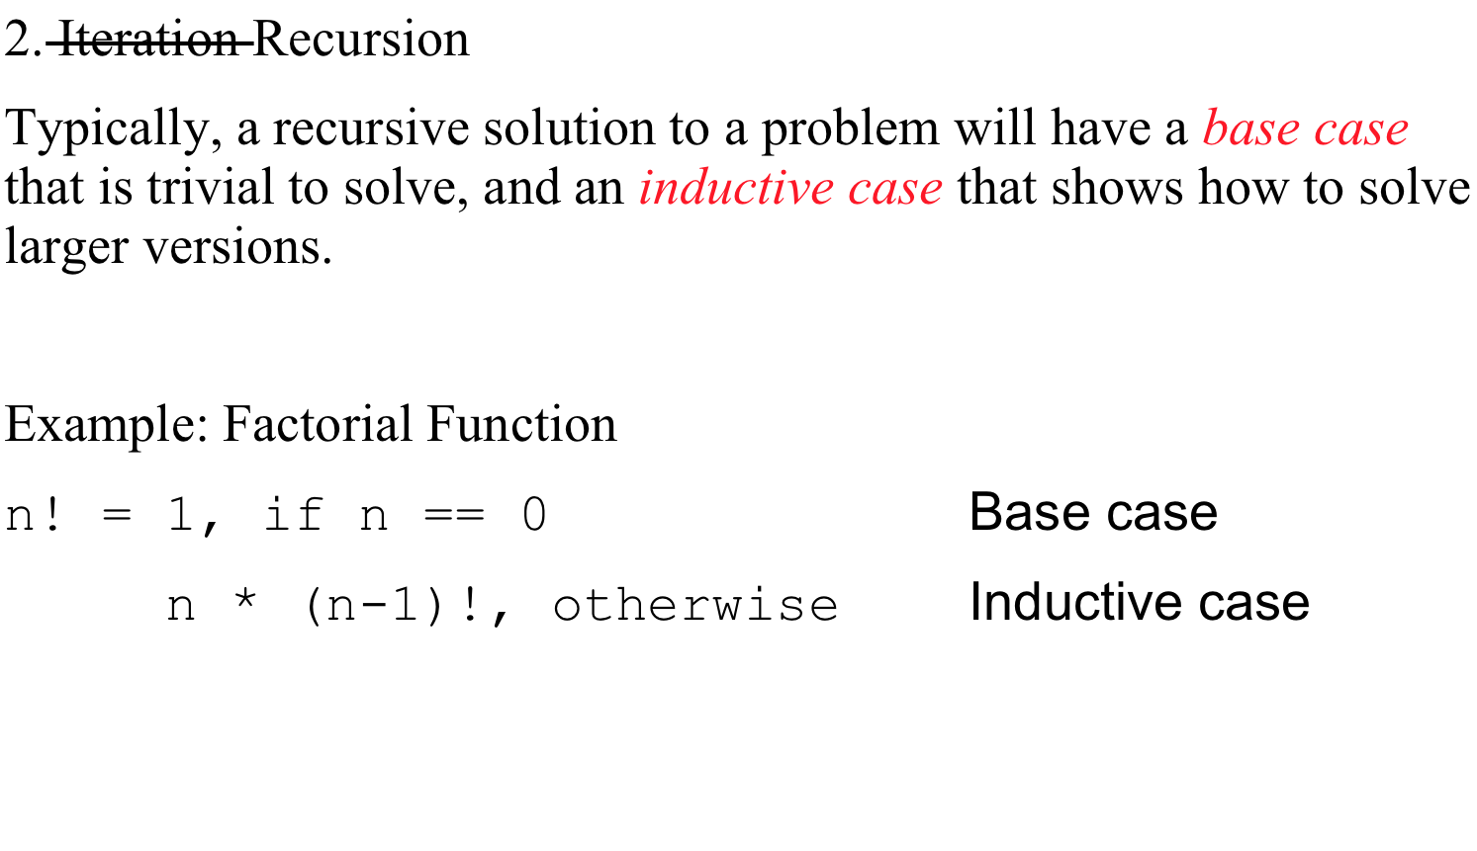
Common Elements of Functional Languages

Slide 18
Common Elements of Functional Languages
2. Recursion
Example: Reverse a linked list.
def reverse(x):
if x:
#x has at least 1 element; call it y
#the reverse of x will be the result of
#appending y to the reverse of x without y
return reverse(x[1:]) + [x[0]]
else:
#x must be an empty list.
#the reverse of an empty list is an empty list
return []
Note: This example makes use of Python's list-slicing syntax. The expression x[1:] should be read as “All elements of the list x, starting from index 1.”

Slide 19
Common Elements of Functional Languages
2. Recursion
Example: Create a list of n increasing integers, e.g. [0,1,2,3].
Sometimes, recursive calls need more parameters than the function interface should require. In these cases, helper functions can be used to pass the extra data.
def helper(n, x):
if x == n:
return []
else:
return [x] + helper(n, x + 1)
def counter(n):
return helper(n, 0)

Slide 20
Common Elements of Functional Languages
2. Recursion
Example: Create a list of n increasing integers, e.g. [0,1,2,3].
Sometimes, recursive calls need more parameters than the function interface should require. In these cases, helper functions can be used to pass the extra data.
def helper(n, x):
if len(x) == n:
return x
else:
return helper(n, x + [len(x)])
def counter(n):
return helper(n, [])
Alternative
Solution

Slide 21
Common Elements of Functional Languages
2. Recursion
In imperative languages:
Looping is easy and fast
Recursion has overhead; each call creates a stack frame
In functional languages:
Looping is heavily discouraged
Can be efficient via advanced data structures outside of the scope of this class

Slide 22
Common Elements of Functional Languages
3. Higher-order functions
Write two functions: one that adds 1 to every integer in a list, and another that multiplies every integer in a list by 2.

Slide 23
Common Elements of Functional Languages
3. Higher-order functions
Write two functions: one that adds 1 to every integer in a list, and another that multiplies every integer in a list by 2.
Notice that all the looping code gets duplicated!
void addOne(ListNode *head) {
ListNode *cur = head;
while (cur != NULL) {
cur->data = cur->data + 1;
cur = cur->next;
}
}
void multTwo(ListNode *head) {
ListNode *cur = head;
while (cur != NULL) {
cur->data = cur->data * 2;
cur = cur->next;
}
}

Slide 24
Common Elements of Functional Languages
3. Higher-order functions
A better way: refactor the looping code common to the addOne and multTwo functions into a single function.
def each(node, f):
if node:
node.data = f(node.data)
each(node.next, f)
def addOne(node):
each(node, lambda x: x + 1)
def multTwo(node):
each(node, lambda x: x * 2)

Slide 25
Common Elements of Functional Languages
3. Higher-order functions
Higher-order function: a function that accepts a function as a parameter, or returns a function as its result
def each(node, f):
if node:
node.data = f(node.data)
each(node.next, f)
def addOne(node):
each(node, lambda x: x + 1)
def multTwo(node):
each(node, lambda x: x * 2)

Slide 26
Common Elements of Functional Languages
3. Higher-order functions
First-class functions: functions that can be dynamically created, assigned to variables and be passed as arguments to (or returned as values from) other functions, like any other kind of data.
def each(node, f):
if node:
node.data = f(node.data)
each(node.next, f)
def addOne(node):
each(node, lambda x: x + 1)
def multTwo(node):
each(node, lambda x: x * 2)

Slide 27
Common Elements of Functional Languages
3. Higher-order functions
First-class functions: functions that can be dynamically created, assigned to variables and be passed as arguments to (or returned as values from) other functions, like any other kind of data.
Question: Does C++ have first-class functions?

Slide 28
Common Elements of Functional Languages
3. Higher-order functions
First-class functions: functions that can be dynamically created, assigned to variables and be passed as arguments to (or returned as values from) other functions, like any other kind of data.
Question: Does C++ have first-class functions?
Answer: No. Function pointers can mimic some of these behaviors, but there is no way to create new functions dynamically.

Slide 29
Common Elements of Functional Languages
3. Higher-order functions
Functional language: a language that has first-class functions.
def each(node, f):
if node:
node.data = f(node.data)
each(node.next, f)
def addOne(node):
each(node, lambda x: x + 1)
def multTwo(node):
each(node, lambda x: x * 2)

Slide 30
Common Elements of Functional Languages
3. Higher-order functions
Important higher-order functions:
map: Given a function for transforming data, and a list of data to be transformed, return a list of the transformed data.
Examples:
> map (lambda x: x + 2, [1, 2, 3])
[3, 4, 5]
> map (lambda x: chr(x), [104, 101, 108, 108, 111])
['h', 'e', 'l', 'l', 'o']

Slide 31
Common Elements of Functional Languages
3. Higher-order functions
Important higher-order functions:
map: Given a function for transforming data, and a list of data to be transformed, return a list of the transformed data.
def map (f, xs):
  if xs:
    return [f(xs[0])] + map (f, xs[1:])
  else:
    return []

Slide 32
Common Elements of Functional Languages
3. Higher-order functions
Important higher-order functions:
filter: Given a function deciding whether an item should be kept, and a list of items, return a list containing only items that should be kept.
Examples:
> filter (lambda x: x % 2 == 1, [1, 2, 3])
[3, 5]
> filter (lambda x: x.isupper(), “My Name Is Hal”)
['M', 'N', 'I', 'H']

Slide 33
Common Elements of Functional Languages
3. Higher-order functions
Important higher-order functions:
filter: Given a function deciding whether an item should be kept, and a list of items, return a list containing only items that should be kept.
def filter (f, xs):
  if not xs:
    return []
  elif f(xs[0]):
    return [xs[0]] + filter(f, xs[1:])
  else:
    return filter(f, xs[1:])

Slide 34
Common Elements of Functional Languages
3. Higher-order functions
Important higher-order functions:
reduce: Given a function for combining a list item and a seed value into a new seed value, a list of items, and an initial seed value, recursively apply the function to the list items to arrive at a single value
Examples:
> reduce (lambda seed,x: seed + x, [1, 2, 3], 0)
6
> reduce (min, [5,8,4,2,1,7,6,3,9], 10)
1
> reduce (min, [5,8,4,2,1,7,6,3,9], 0)
0

Slide 35
Common Elements of Functional Languages
3. Higher-order functions
Important higher-order functions:
reduce: Given a function for combining a list item and a seed value into a new seed value, a list of items, and an initial seed value, recursively apply the function to the list items to arrive at a single value
reduce(f, [1,2,3], seed)
f
f
3
f
2
seed
1

Slide 36
Common Elements of Functional Languages
3. Higher-order functions
Important higher-order functions:
reduce: Given a function for combining a list item and a seed value into a new seed value, a list of items, and an initial seed value, recursively apply the function to the list items to arrive at a single value
reduce(min, [1,2,3], 5)
min
min
3
min
2
5
1

Slide 37
Common Elements of Functional Languages
3. Higher-order functions
Important higher-order functions:
reduce: Given a function for combining a list item and a seed value into a new seed value, a list of items, and an initial seed value, recursively apply the function to the list items to arrive at a single value
reduce(min, [1,2,3], 5)
min
min
3
1
2

Slide 38
Common Elements of Functional Languages
3. Higher-order functions
Important higher-order functions:
reduce: Given a function for combining a list item and a seed value into a new seed value, a list of items, and an initial seed value, recursively apply the function to the list items to arrive at a single value
reduce(min, [1,2,3], 5)
min
1
3

Slide 39
Common Elements of Functional Languages
3. Higher-order functions
Important higher-order functions:
reduce: Given a function for combining a list item and a seed value into a new seed value, a list of items, and an initial seed value, recursively apply the function to the list items to arrive at a single value
reduce(min, [1,2,3], 5)
1

Slide 40
Common Elements of Functional Languages
3. Higher-order functions
Important higher-order functions:
reduce: Given a function for combining a list item and a seed value into a new seed value, a list of items, and an initial seed value, recursively apply the function to the list items to arrive at a single value
def reduce(f, xs, seed):
  if xs:
    return reduce(f, xs[1:], f(seed, xs[0]))
  else:
    return seed

